Slide 1
Paul Stoffels, MD
Vice Chairman, Chief Scientific Officer, Johnson & Johnson

Slide 2
Disclosure of Speaker Interests
Relation relevant to the meeting | Company name
Vice Chair of the Executive Committee and Chief Scientific Officer | Johnson & Johnson

Slide 3
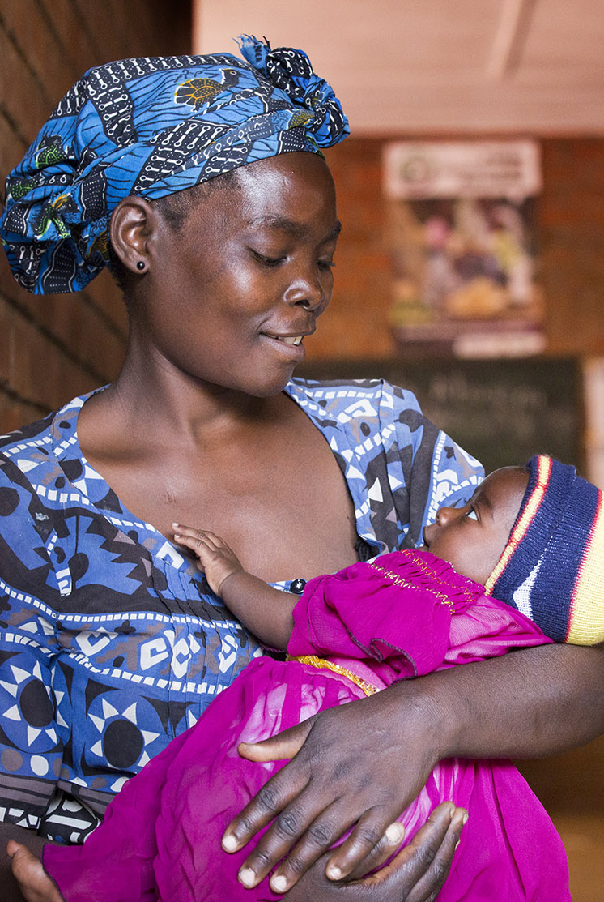
Industry Has Delivered Significant Impact In HIV
From clinical end points to biomarker-based approval
20 new drugs in 20 years
From 20-30 pills a day to one pill a day
From 2 years life expectancy in 1983 to near normal life expectancy today
21.7 mm people on therapy globally through innovative access models
Projection: 300 Million years of life saved
Notes:
http://www.who.int/hiv/mediacentre/news/global-aids-update-2016-news/en/

Slide 4
HIV Remains a Critical, Growing Global Concern
36.7M
The Interventions
  More than 20 Antiretroviral Drugs and combinations
  Diagnostics : CD4, Viral Load, Resistance Testing
The Challenges
  Life-long therapy (30-50 years):
  major manufacturing challenge
  Highly mutable virus leading to resistance
  Supply Chain, Logistics,
  Funding
people living
with HIV
2.1M
new HIV infections
annually
1.1M
deaths annually from
AIDS, 70% in Africa
What’s Needed: Innovation in Therapy, Access, Prevention, and Cure
Source: World Health Organization (WHO), April 2017.

Slide 5

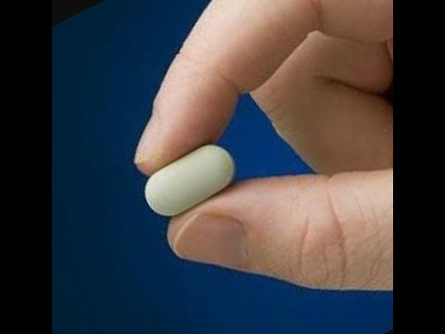
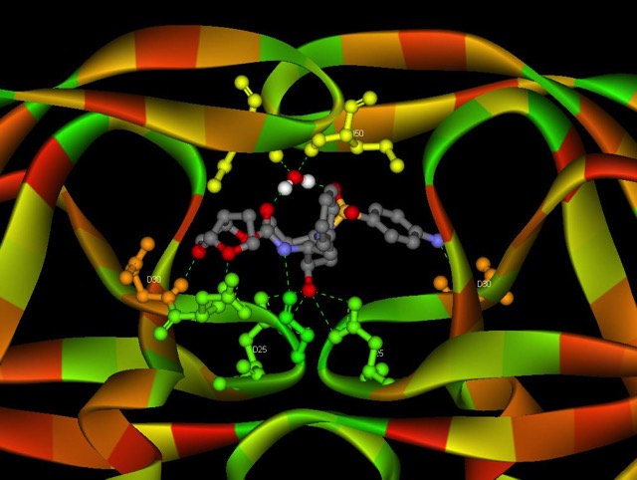

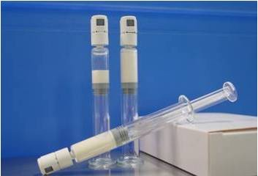
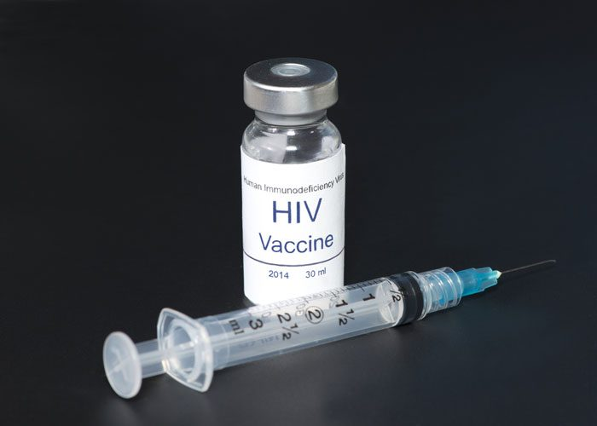

Working Together To Make HIV History: A story of Public Private Partnership
Treatment:
%
Collaboration with NIH, Industry, Governments, Regulators, Patients, Civil Society
Prevention:
Collaboration with IPM, patients, local governments
Collaboration with ViiV Healthcare
Gates Foundation
NIH
BIDMC/Harvard
HVTN
NIH-NIAID-DAIDS
Ragon Institute
MHRP
IAVI

Slide 6

Status of HIV Vaccine
Strong protection in non-human primates
APPROACH study correlates of protection
  Nearly 400 people
  Durable protection after 1 year of vaccination
Phase 2b IMBOKODO trial: >400 / 2600 recruited
Global collaboration:
  Gates Foundation
  Beth Israel Deaconess Medical Center, Harvard Medical School
  US Military HIV Research Program
  NIAID/NIH
  Ragon Institute
  IAVI
  HVTN / MRC SA
Notes:
http://www.who.int/hiv/mediacentre/news/global-aids-update-2016-news/en/

